Slide 1


APT35
‘CHARMING
KITTEN'

Slide 2



What is APT35 ‘Charming kitten?
APT35 aka: Charming Kitten, G0059, Magic Hound, Mint Sandstorm, Newscaster Team, Phosphorus, TunnelVision FireEye has identified APT35 operations dating back to 2014.
APT35, also known as the Newscaster Team, is a threat group sponsored by the Iranian government that conducts long term, resource-intensive operations to collect strategic intelligence.
APT35 typically targets U.S. and the Middle Eastern military, diplomatic and government personnel, organizations in the media, energy and defense industrial base (DIB), and engineering, business services and telecommunications sectors.

Slide 3
HOW ATP35 INFILTRATE THE SYTSEM
Use of Malicious Documents APT35 often uses malicious documents (such as Word or PDF files) with embedded macros or exploits to deliver malware.
Malware Delivery: Once the document is opened, the embedded code executes and downloads additional malware onto the system.
Remote Access Trojans (RATs): These allow attackers to control the infected system remotely, facilitating data exfiltration and further infiltration.

Slide 4
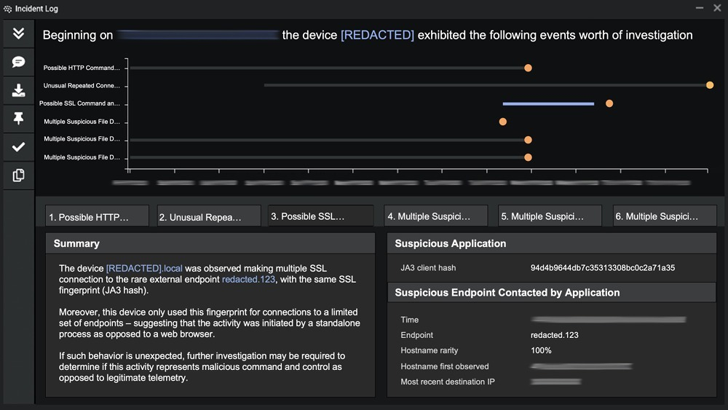
Figure 1: Similar Cyber AI Analyst report observing C2 communications
The Cyber AI Analyst only highlights the most severe incidents in any given environment and automates many of the typical level one and level two SOC tasks. This includes reviewing all alerts, investigating the scope and nature of each event, and reducing time to triage by 92%.

Slide 5
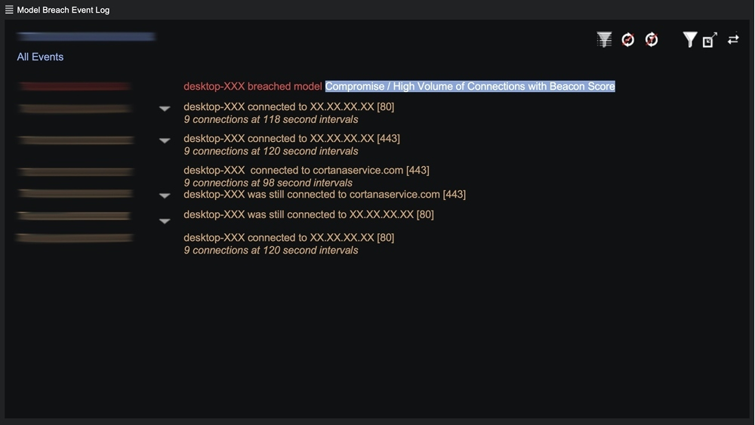
Figure 2: Example list of C2 detections for an APT35 attack

Slide 6
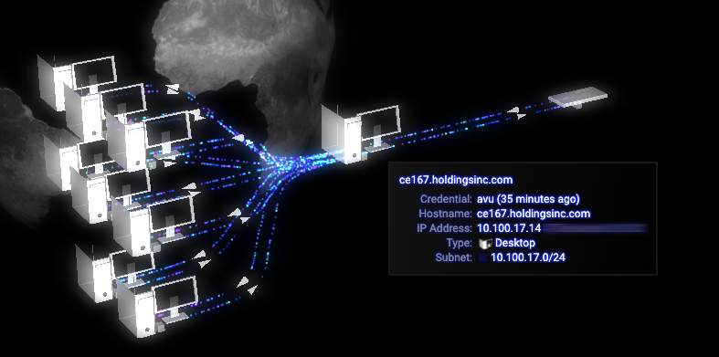
Figure 3: Darktrace’s Threat Visualizer displaying the connectivity of a device

Slide 7
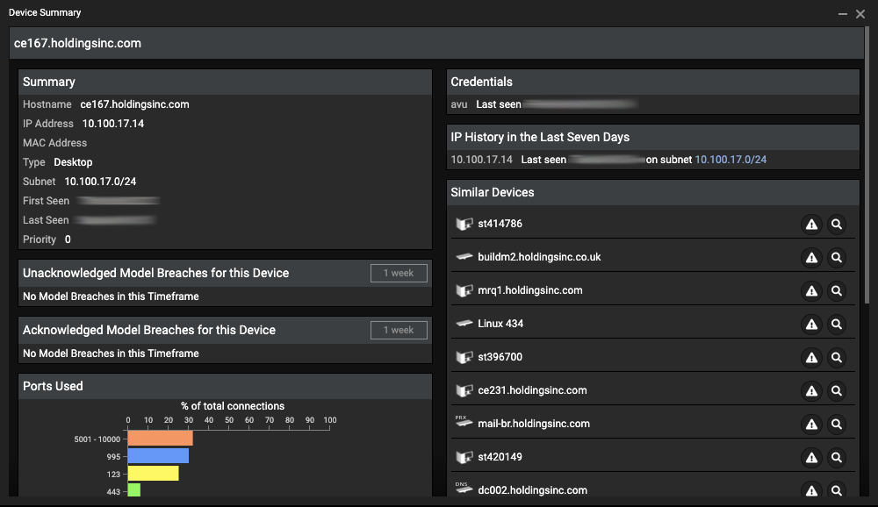
Figure 4: Similar and associated credentials of a device

Slide 8
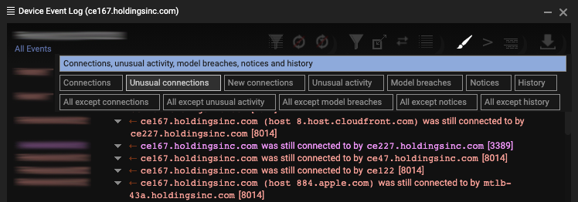
Figure 5: Event device log filtered to show unusual connections only

Slide 9
INFECTION/INITIAL ACCESS
APT35, sometimes referred to as Charming Kitten, Imperial Kitten, or Tortoiseshell, is a notorious cyber-espionage group which has been active for nearly 10 years. Famous for stealing scripts from HBO’s Game of Thrones in 2017 and suspected of interfering in the U.S. presidential election last year, it has launched extensive campaigns against organizations and officials across North America and the Middle East. Public attribution has associated APT35 with an Iran-based nation state threat actor.

Slide 10

PERSISTENCE
Apart from persistent command and control (C2) beaconing, the compromised device did not show any other indications of criminal activity. It waited for the attackers to provide instructions for many days. This is referred to as lying low the hacker continues active within a system but stays out of sight, evading discovery either on purpose or because they are happy to have backdoor access into the company and are concentrating on another target. APT that has gained a footing and is waiting to carry out their assault covertly is, in any case, a nightmare situation for a security team and any security provider

Slide 11
Communication Methods HTTP/HTTPS
APT35 frequently uses HTTP and HTTPS protocols for C2 communications.
HTTPS, in particular, helps in evading detection by encrypting the traffic, making it harder for security solutions to inspect the contents.
DNS Tunneling: They have also employed DNS tunneling, a method of encoding data within DNS queries and responses, to communicate with the C2 server. This can bypass traditional network defenses.
Social Media and Email: The group has utilized social media platforms and email for C2 communications. This involves using direct messages or specially crafted emails to send commands and receive data from infected systems.

Slide 12
Command and Control (C2)
C2 Infrastructure
1. Domain Fronting: APT35 has been known to use domain fronting, a technique where the malware communicates with a benign-looking domain that redirects traffic to the actual C2 server. This method helps evade detection by blending in with legitimate traffic.
2. Compromised Websites: They often use compromised legitimate websites as C2 servers. This makes detection more difficult, as traffic to these sites might appear normal.
3. Cloud Services: They have been observed using cloud services such as Dropbox, Google Drive, and others for C2 communications. These services are less likely to be blocked and can disguise malicious traffic as legitimate..

Slide 13
Reference

